Slide 1
Ease Your Path to HIPAA Best Practice
How Can a Hybrid Cloud Strategy Benefit Your Customer?
Notes:
Mike

Slide 2
Founded in 1974 - 40+ years
Headquarters - Nagoya, Japan
Publically Traded on Nikkei
North American HQ – Austin, TX
Award winning North American Tech Support
a
Committed to SMB
Purpose Built Engineered Products & Solutions
CDW dedicated resources
Network Storage & Networking Product Strength
Notes:
Mike

Slide 3
Details about HIPAA Storage
Is there a certification to become HIPAA Compliant?
No, there is no HIPAA certification for data storage but there is a HIPAA storage best practice that should be followed.
RAID5
What does it mean to store data in HIPAA best practices?
Save yourself the hassle of calling different manufacturers for drive or chassis support
Storing information and data in HIPAA best practices means ensuring that the data is physically and digitally secure.
Notes:
Mike

Slide 4
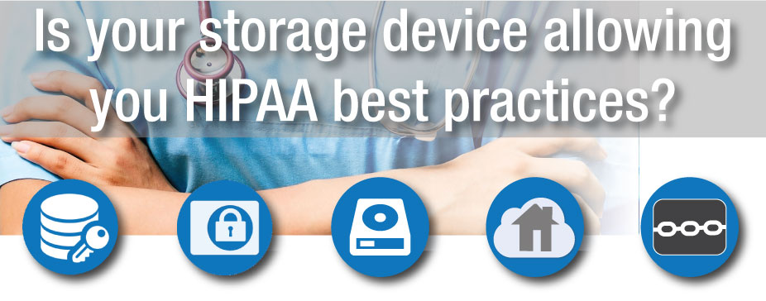
HIPAA Best Practice Atmosphere
Increasing Data & Increased Risks
RAID5
Data breaches are increasing across industries, including healthcare; and the pressure to safeguard sensitive patient information is stronger than ever.
Medical offices and hospitals are in the business of caring for patients and saving lives, and there are many paths to HIPAA best practices they may not be aware of.
Notes:
Mike

Slide 5
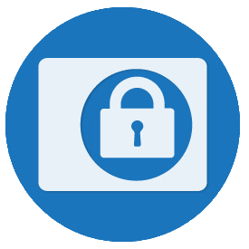
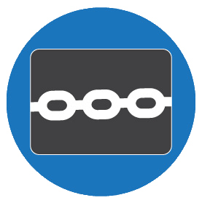
Built-In Security Measures
Physically Block Access to NAS Devices & Data
1. Boot Authentication prevents unauthorized users from accessing the information on your storage device if it is removed or stolen. This feature requires the NAS to authenticate against a local authentication server before boot up and information on the hard disk becomes readable.
RAID5
2. Locking Mechanisms: Kensington Security Slot on desktop and rackmount units enables you to physically secure your device to a fixed location. Front Panel Lock desktop systems include a locking front panel discouraging removal of drives from your device.
Notes:
Mike

Slide 6
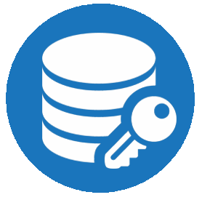
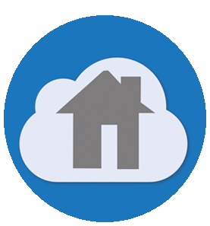
Built-In Security Measures
Safeguard Sensitive Information Stored Digitally
1. AES 256-bit encryption (Advance Encryption Standard) adds another layer of protection by encrypting sensitive patient data and records that are stored on your device. Proper authorization is needed to access that information.
RAID5
2. Private Cloud (TeraStation Replication) model enables you to back up, store, and share information in a manner that is in line with HIPAA best practice recommendations where data is physically stored on systems maintained by your organization instead of public cloud environments which are more susceptible to hack attempts.
Notes:
Mike

Slide 7
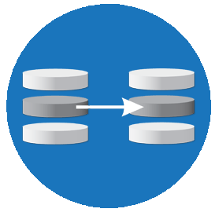
Built-In Security Measures
Safeguard Sensitive Information Stored Digitally
3. Rsync compatibility makes it easier for healthcare facilities to create a HIPAA best practice private cloud model. Rsync compatibility allows you to replicate information between your Buffalo TeraStation NAS and a third-party NAS device that is also Rsync compatible.
RAID5
4. Keep Your Drive Warranty Services helps organizations meet HIPAA mandates that require you to retain storage drives and require paperwork for retention of drives. This service allows organizations to achieve HIPPA best practice requirements by retaining defective hard drives and destroying them in-house.
Notes:
Mike

Slide 8
Built-In Security Measures
Additional Best Practices
When replicating data offsite to other TeraStations or Rsync-enabled devices, it is recommended to use a secure VPN. Users will have double layer data security when files are encrypted on the TeraStation and replicated through a secure VPN tunnel.
VPN tunnel capabilities can be utilized by Buffalo TeraStation devices when partnered with third-party hardware that includes this functionality.
RAID5
Notes:
Mike

Slide 9
Built-In Security Measures
Additional Best Practices
When choosing a backup storage solution, ensure that your device is compatible within your environment.
Buffalo offers both Windows based and Linux based TeraStation NAS devices to physically and digitally store & secure your data.
RAID5
Notes:
Mike

Slide 10
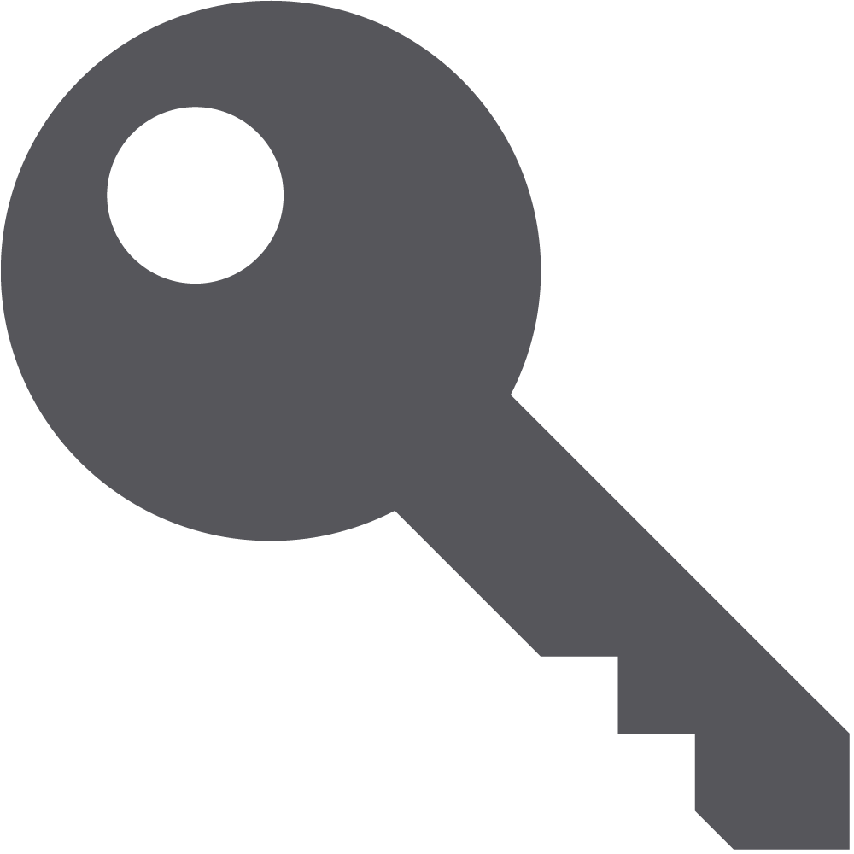
TeraStation
Purpose Built SMB Storage
Relevant Purpose-built Solution
TeraStation storage devices are designed for use by small business, SMB, and entry-level enterprise environments.
Ease of use
Our network storage devices come with hard drives included. This means pre-configured RAID and plug-and-play capabilities & one stop 24/7 US based support by Buffalo/
RAID5
Coverage
Dedicated representatives standing by to help you or your customer identify the correct product for their needs/
Price
Storage is not the first thought for most small businesses. TeraStations are purpose built for the SMB user with SMB price points in mind.
Up to 60 clients
With full access
Notes:
Mike

Slide 11
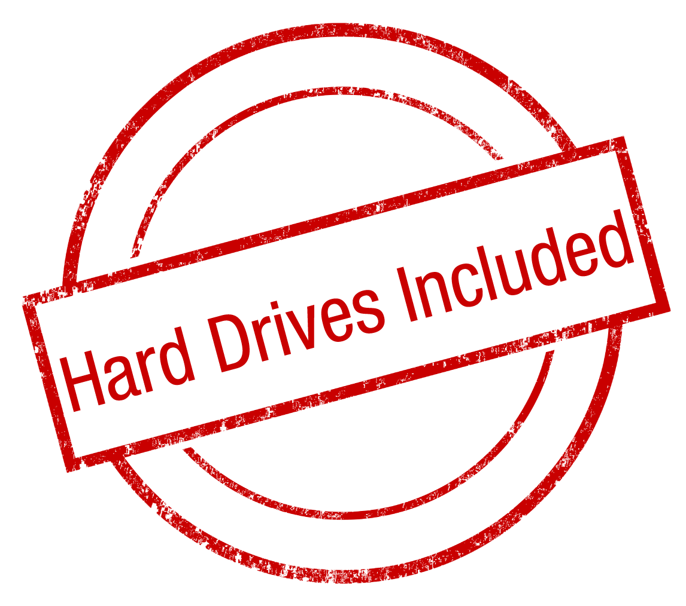
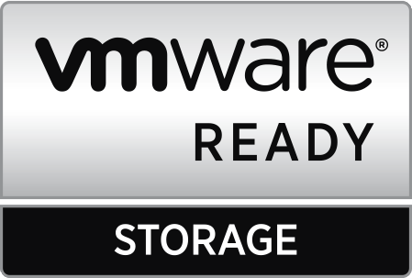
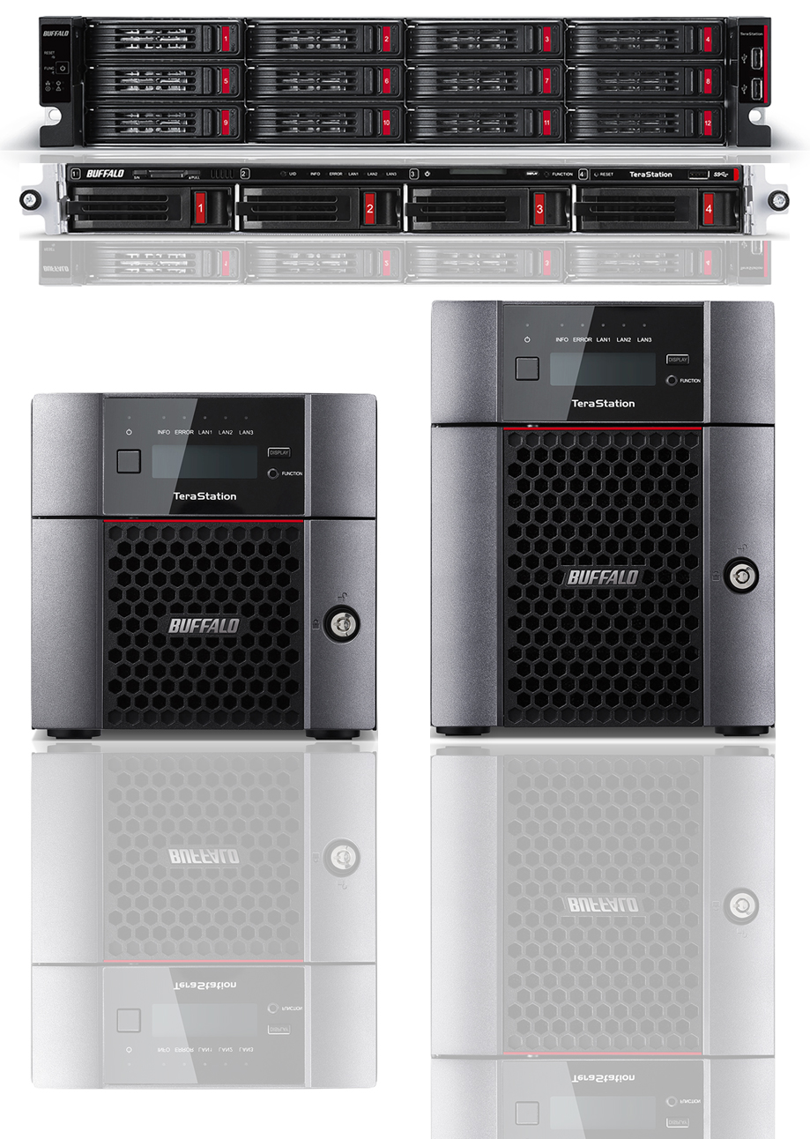
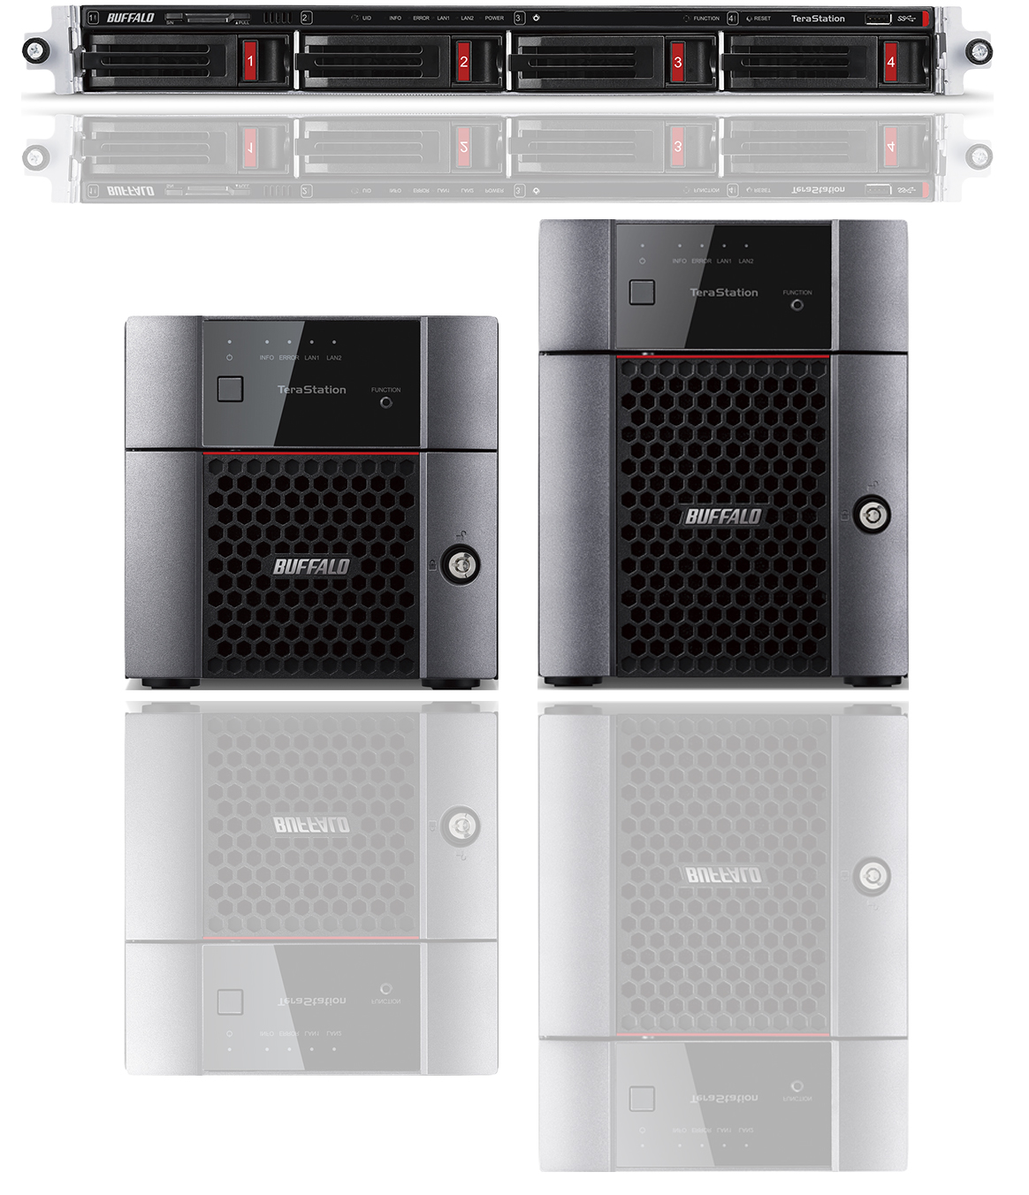
New Buffalo NAS Products
TeraStation
3010 series
TeraStation
5010 series
Use Cases
Hybrid Cloud (featuring Amazon S3, Dropbox, and Azure)
Private Cloud
Basic File Server
iSCSI Storage
Backup Target
Offsite Backup
Disaster Recovery
Surveillance Storage
Notes:
Andrew

Slide 12
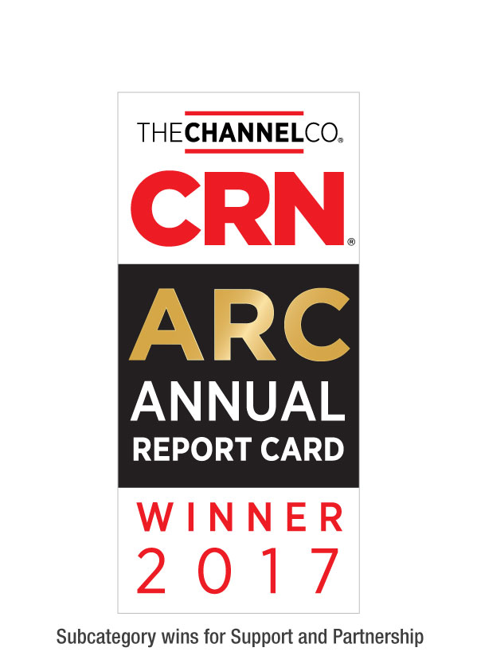
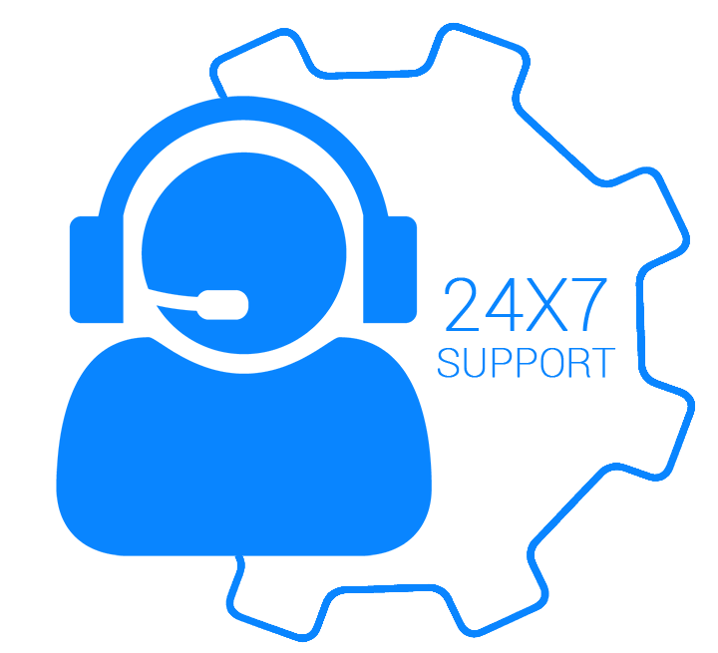
Tech Support
Best support will bring your customer back again.
Award winning US-based technical support
Your customers are in award-winning hands with every purchase.
24/7 North American-Based Phone Support
Easy support access for your customers.
FAQs and easy-to-understand walkthroughs
Find answers to common and not-so-common questions at our knowledge base:
Step by Step setup instructions for all TeraStation features
www.buffaloamericas.com/knowledge-base
Up to 60 clients
With full access
Notes:
Andrew

