Slide 1
Optimizing Revenue in 2019
Notes:
Good morning, good afternoon and good night across the globe … thank you for joining NovaStor and Buffalo for this joint-webinar on Optimizing Revenue BEAT and that ever-looming threat of Cyber Attack and its ugly monster RansomWare

Slide 2
Take-Aways:
Protect your customers against cyberattacks
Maximize revenue with NovaStor and Buffalo
Optimizing recurring earnings with flexible licensing models
Notes:
READ SLIDE

Slide 3
NovaStor & Buffalo Bundles
Bundled Inclusions in Storage Solution
The Market‘s Most Secure Storage Solution
AND
FREE Award-Winning NovaStor Software:
WITHIN THE LINKSTATIONS
5 NovaStor PC licenses
WITHIN THE TERASTATIONS
10 NovaStor PC licenses
+
NovaStor Server license
Product Features
Backup & Disaster Recovery (BDR)
Central Monitoring
Reporting
US-based Tech Support
Data Security
Custom packages are available
Notes:
Bundled in Market‘s Most Secure Storage Device is NovaStor‘s Award-Winning Backup Software:
As many of you know, WITHIN THE LINKSTATIONS you receive 5 NovaStor PC licenses … BEAT …WITHIN THE TERASTATIONS you’ll receive 10 NovaStor PC licenses plus a NovaStor Server license.
The Product Features are: Backup & Disaster Recovery (BDR), Central Monitoring, Reporting, US-based Tech Support, Data Security ... BEAT ... For custom packages and appliances please contact me.
Our software protects your data against cyberattacks with our BMR Imaging capabilities. We have the ability to restore an image to dissimilar hardware providing you a quick restore of the os, the drivers, the applications, the software with the same look and feel BEAT or create a vhd with our P to V feature-set.
JACK short … Gary

Slide 4
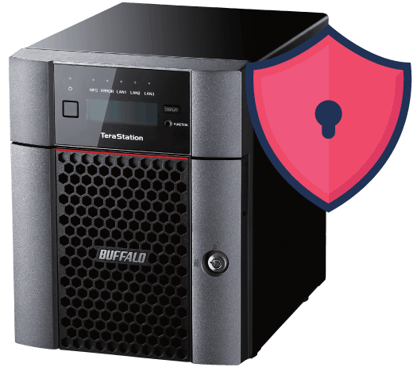
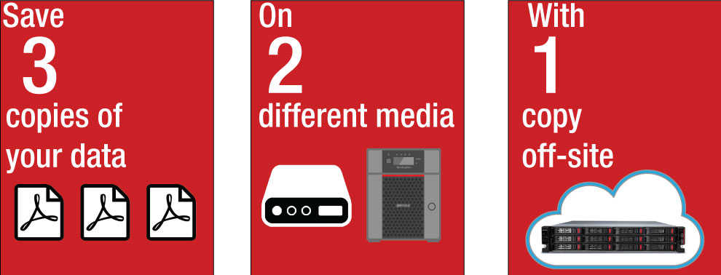
Protect Your Data
Ransomware Attacks Cannot Be Eliminated Completely.
You can take action to minimize the threat of ransomware to protect valuable data.
We recommend the proactive 3-2-1 Backup Strategy
The 3-2-1 strategy is when you have at least 3 total copies of your data, 2 of which are local but on different devices, and at least 1 copy offsite.
RAID5
Save yourself the hassle of calling different manufacturers for drive or chassis support

Slide 5
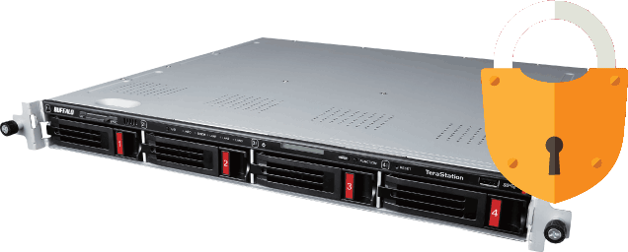
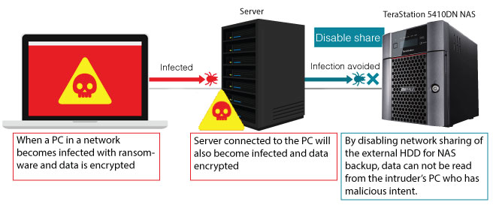
The Market’s Most Secure NAS
The best measure of defense is a proactive backup strategy
You can take action to minimize the threat of ransomware to protect valuable data.
RAID5

Slide 6
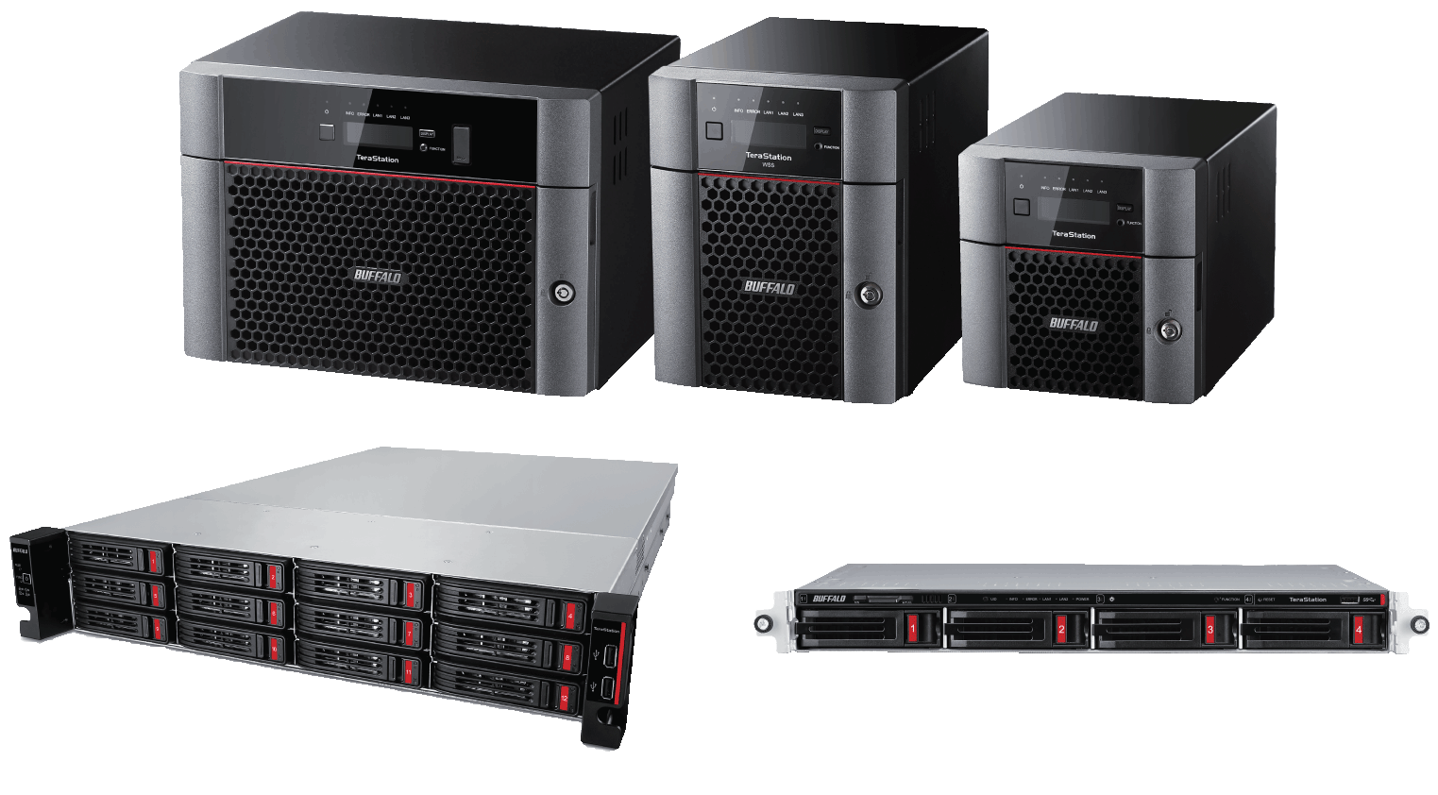
The Market’s Most Secure NAS
The Most Secure Network Attached Storage on the Market
RAID5
RAID5
Closed system
Data Encryption
Backup, replication, failover and encryption
Secure Set-up
Passwords
Anti-Theft Features
Anti-Virus

Slide 7
Let‘s Sum It Up
Opportunities of Revenue
Ransomware Protection
Flexibility of NovaBACKUP products and license models
The MSP Program
The NovaStor & Buffalo Bundles
Methods of protecting your data with Buffalo and NovaStor:
321 Backup rule
Backup to a NAS device
Bare-metal restore
Notes:
There‘s Flexibility of NovaBACKUP products and license models, The MSP Program offers a range of revenue opportunites, be a saavy partner The NovaStor & Buffalo Bundles included is Buffalo‘s Storage Solutions
3, 2, 1 as Gray said ... :

Slide 8
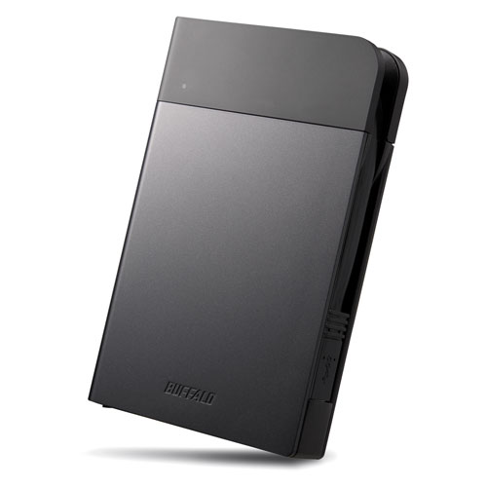
Drawing
All webinar participants are entered to win a MiniStation™ Extreme NFC
Rugged portable hard drive equipped with a unique wrap-around USB cable and secure hardware encryption.
And the winner is….
Buffalo Americas will contact you with details about your prize soon
MiniStation™ Extreme NFC
Notes:
Announce winner First name and Initial

Slide 9
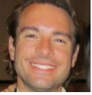
Contact
Eric LeMarque Strategic Partnerships Direct: (805) 435-0061 eric@novastor.com
Jack Lunkiewicz Head of Technical Support Phone: (805) 579-5442 jack@novastor.com
Gary Thomas Senior Technician Phone: 800-688-7466 support@buffaloamericas.com
Matt Penico Marketing and Communications Direct: 512-349-1330 matthew.penico@buffaloamericas.com

